Slide 1
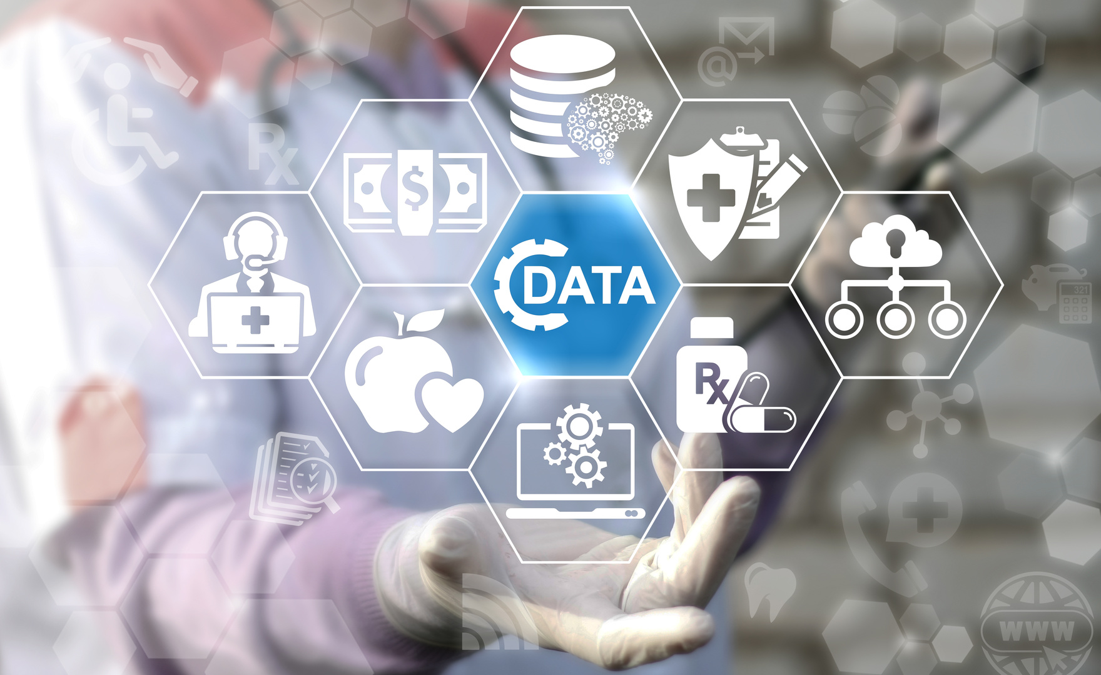
Diabetes Prevalence and Glycemic Control among Adults of Age 20 Years and over, by Sex, Age, Race and Federal Poverty Level in the United States of America in the Selected Years of 2015 – 2018
DATA ANALYSIS REPORT
PRESENTED BY:
YATISHA RAJANALA
G01419023 – HAP-618-003 – FINAL PROJECT PRESENTATION
Spring 2023

Slide 2
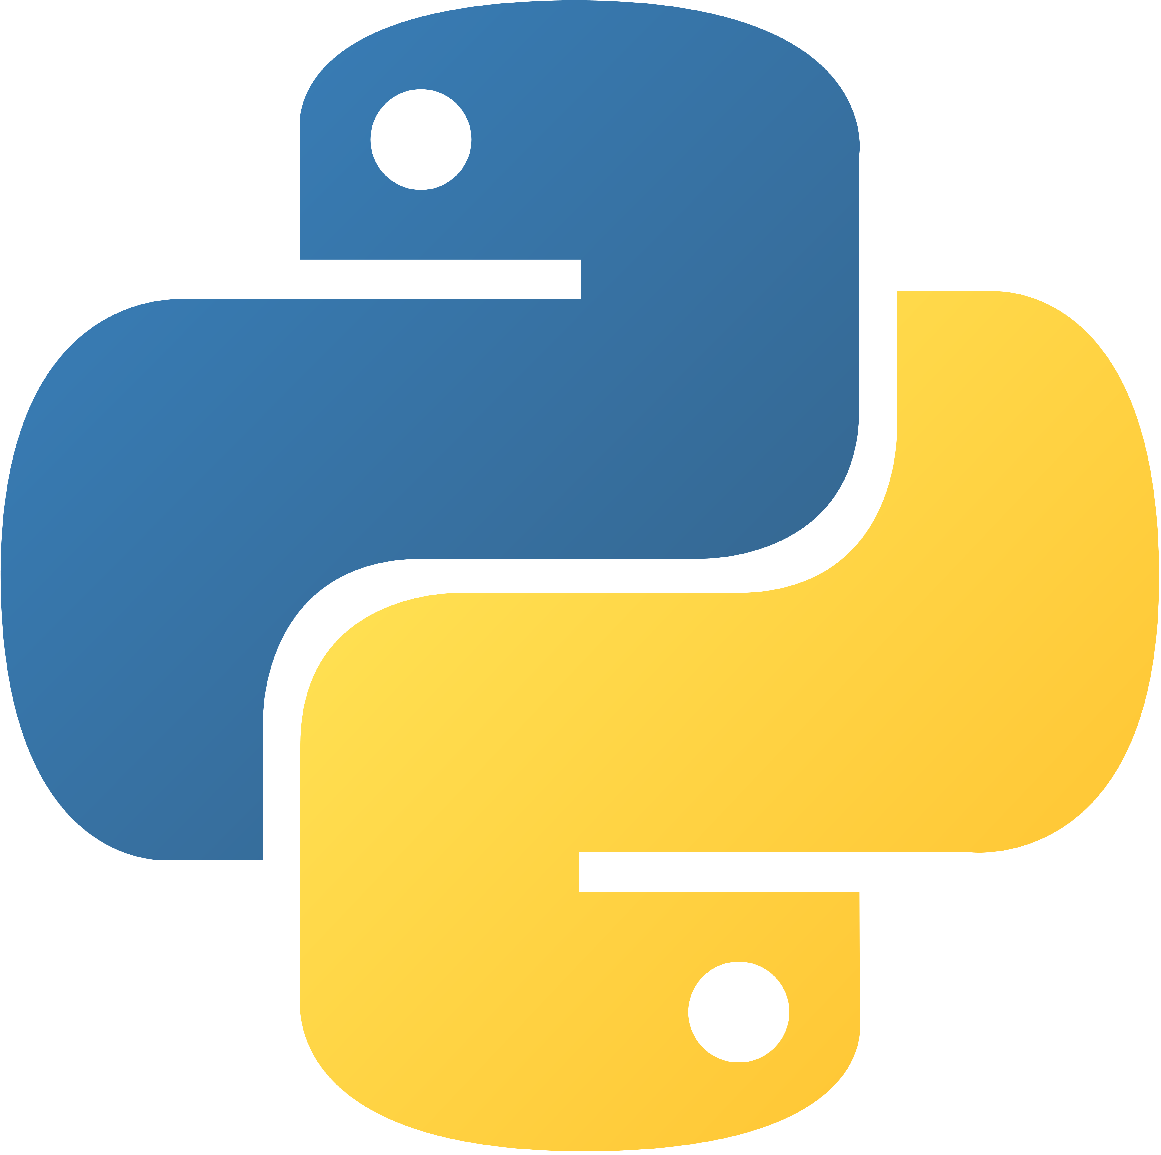
Python In Healthcare
Python is an open-source language that allows building Innovative Healthcare Solutions that can provide better patient outcomes and lead to improved care delivery.
Python complies with the Health Insurance Portability and Accountability Act of 1996 (HIPAA) checklist for ensuring Medical Data Safety.
The principal applications of Python in healthcare are based on Machine Learning (ML) and Natural Language Processing (NLP) algorithms, mainly to build algorithms and software applications for:
Performing Medical Diagnostics
Improving Efficiency of Hospital Operations
Genomic Studies
Drug Discovery
Predictive Analytics

Slide 3
SIGNIFICANCE OF Data Analysis
IDENTIFYING TRENDS
PLANNING INTERVENTIONS
EVALUATION OF EXISTING PROGRAMS
RESOURCE ALLOCATION

Slide 4
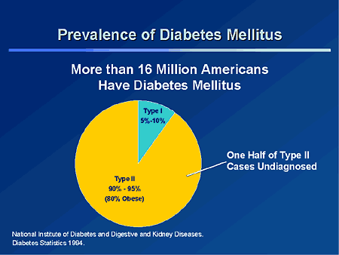
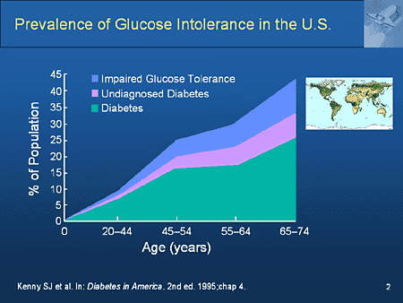
Why is DIABETES prevalent in the u.s.a?

Slide 5
COMPONENTS OF Python Used for data analysis
PANDAS
NUMPY
MATPLOTLIB
Pandas is a Python Library used for working with Data Sets or Data Frames.
It has Functions for Analyzing, Cleaning, Exploring, and Manipulating Data.
NumPy is a Python Library that helps in Numerical Computing.
It has Functions for performing Complex Mathematical Computations on Datasets.
Matplotlib is a Python Library that helps in Data Visualization.
It has Functions for creating Static, Animated, and Interactive Plots and Graphs.

Slide 6
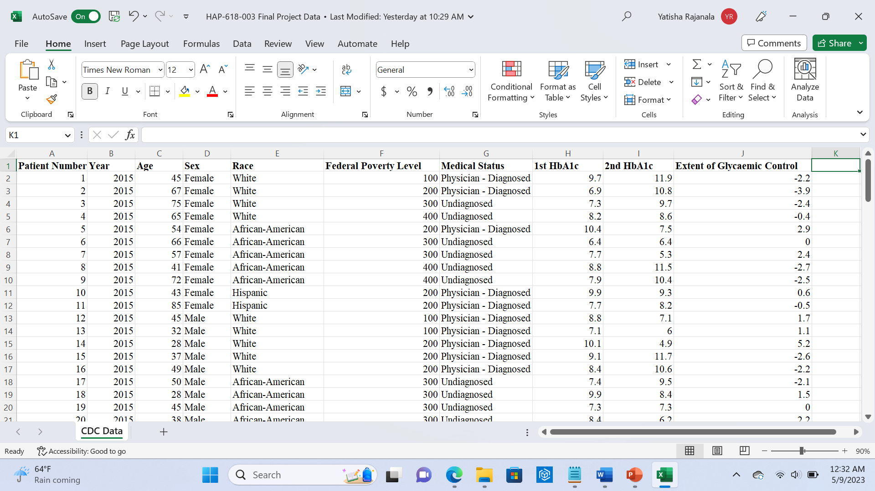
Data from Centers for Disease Control and Prevention (cdc)

Slide 7
Aim of data analysis
REPORT RESULTS ON WEB PAGE
CALCULATE THE PREVALENCE OF DIABETES IN THE U.S.A. IN THE YEARS OF 2015-2018
COMPARE THE DATA IN THE GIVEN YEARS
ANALYZE AND VISUALIZE DATA FOR CLEAR COMPREHENSION
DRAW INFERENCES AND CONCLUSIONS

Slide 8
STEPS OF data analysis
COLLECT, CLEAN AND CONSOLIDATE DATA
CALCULATE PERCENTAGE OF OCCURENCES USING PANDAS
CALCULATE MEAN AND STANDARD DEVIATION USING NUMPY
PLOT BAR GRAPHS USING MATPLOTLIB
PLOT CORRELATION CHARTS USING MATPLOTLIB
COLLECT RESULTS AND FINALIZE REPORT ON WEB PAGE

Slide 9

Prototype CODE

Slide 10

Data analysis outcomes

Slide 11
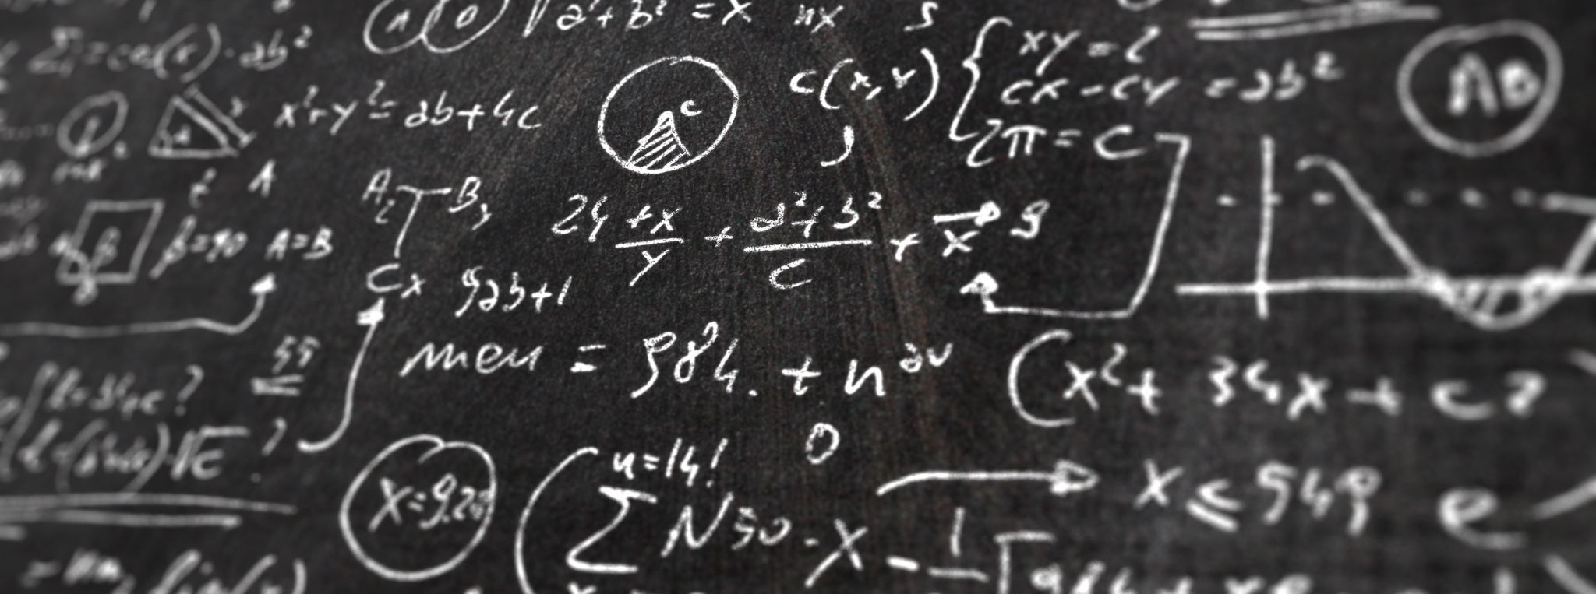
INFERENCES

Slide 12
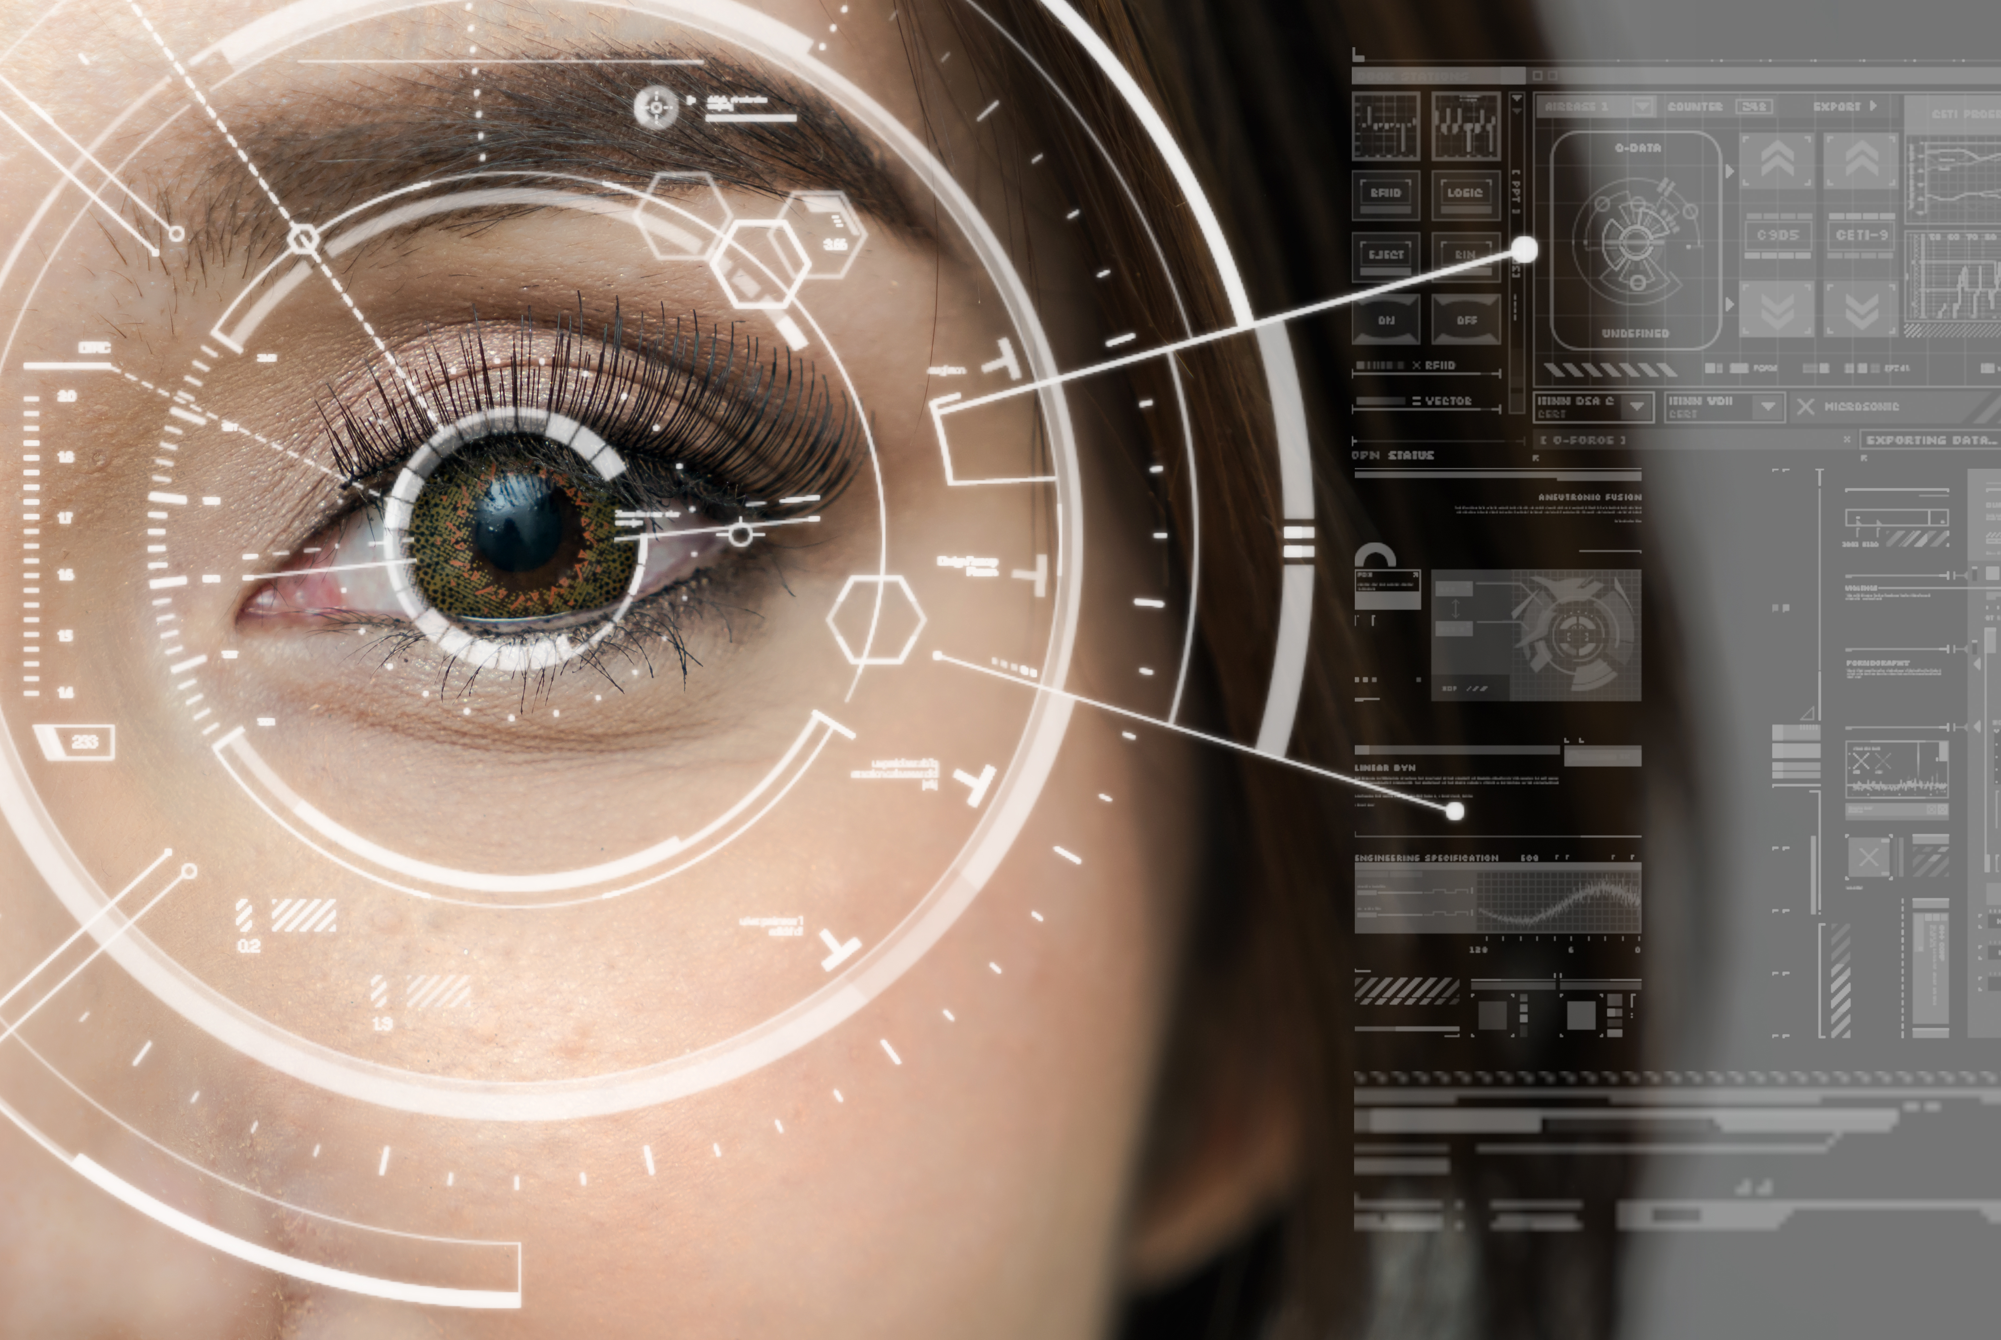
FUTURE PROSPECTS
Personalized Medicine for Each Individual Patient
Predictive Analytic Models
Health System Improvements
Amendments of Public Health Policies
Collaborative Research
Development of Healthcare Devices

Slide 13
REFERENCES
Barot, P. (2020, September 28). Why use Python for building a Healthcare Application. BoTree Technologies. https://www.botreetechnologies.com/blog/python-in-healthcare-application
Dsilva, D., Cudney, E. A., & Shah, H. A. (2018). Data analytics in healthcare: Past, present, and future. American Journal of Industrial and Business Management, 8(1), 147-157.
International Diabetes Federation. (2021). IDF Diabetes Atlas 10th edition 2021. Diabetesatlas.org. https://diabetesatlas.org/
Matplotlib: Python plotting — Matplotlib 3.1.1 documentation. (2012). Matplotlib.org. https://matplotlib.org
Professor Jinshan Tang (2023, January), PowerPoint Presentations and Class Notes, Master of Science Health Informatics Program, George Mason University.
Python in Healthcare: AI Applications in Hospitals. (n.d.). Www.datacamp.com. https://www.datacamp.com/blog/python-in-healthcare-ai-applications-in-hospitals
Selected Trend Table from Health, United States, 2011. Diabetes prevalence and glycemic control among adults 20 years of age and over, by sex, age, and race and Hispanic origin: United States, selected years 1988 - 1994 through 2015 - 2018 | HealthData.gov. (n.d.). Healthdata.gov. Retrieved May 2, 2023, from https://healthdata.gov/dataset/Selected-Trend-Table-from-Health-United-States-201/qkns-8p7f
Zafar, F., Raza, S., Khalid, M. U., & Tahir, M. A. (2019). Predictive Analytics in Healthcare for Diabetes Prediction. Proceedings of the 2019 9th International Conference on Biomedical Engineering and Technology - ICBET’ 19. https://doi.org/10.1145/3326172.3326213
THANK YOU

